Slide 1
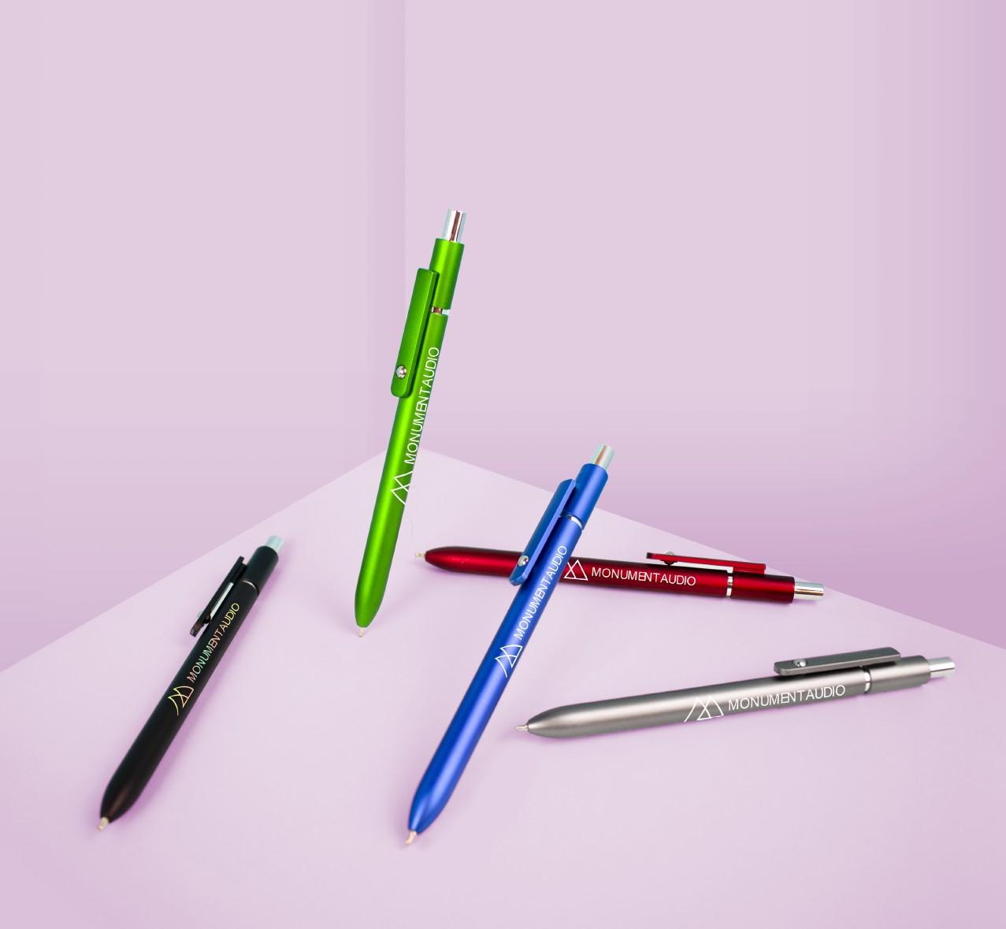
GAZER
(Item No: 241)
The Gazer is sure to impress with its metal pen looks at a plastic pen price. The shimmering metallic finish and shining chrome trim are easy on the eyes, and the metal ball in the clip offers a unique added detail. It also features a generous imprint area for a max advertising opportunity and black hybrid ink for effortless writing.
Full Color
Good through 12/31/2022. 1 Color silkscreen setup $15 (G). Optional full color imprints available, additional charges and restrictions apply. Standard production is 7 business days. FOB MA. All pricing in USD and subject to change.

