Slide 1
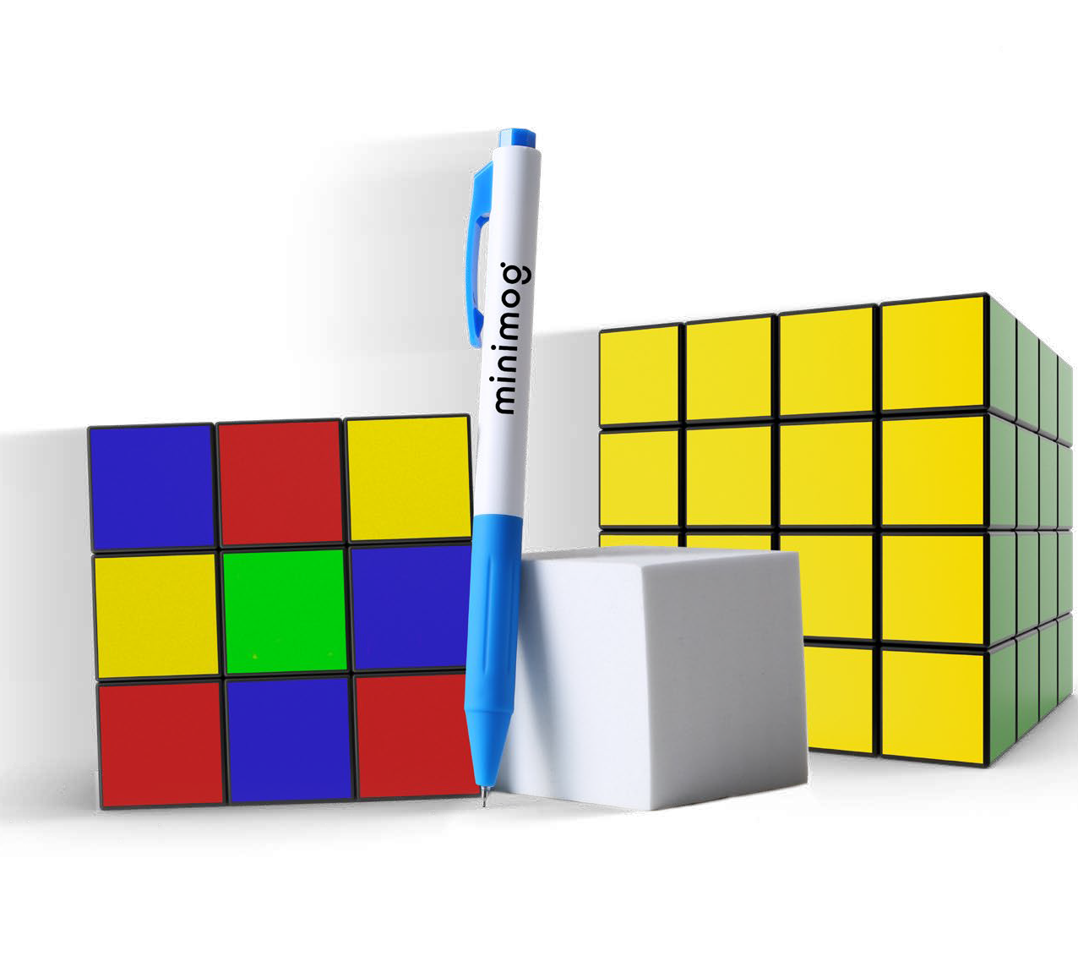
RUBIKS GEL
(Item No: 284)
It's no puzzle the Rubiks Gel makes a perfect promotional pen with its sleek styling and smooth writing. The matte white barrels with classic colored details, grooved rubber grip, and gel ink in a fine point offer writing excellence. The generous imprint area offers a maximum impact so your brand leaves an unforgettable impression.
Rush Full Color 2 Color
1 Color silkscreen setup $15. Free 24 hour rush service available, restrictions apply. Optional two and full color imprints available, additional charges and restrictions apply. Standard production is 5 business days. FOB MA. All pricing in USD and subject to change.

