Slide 1
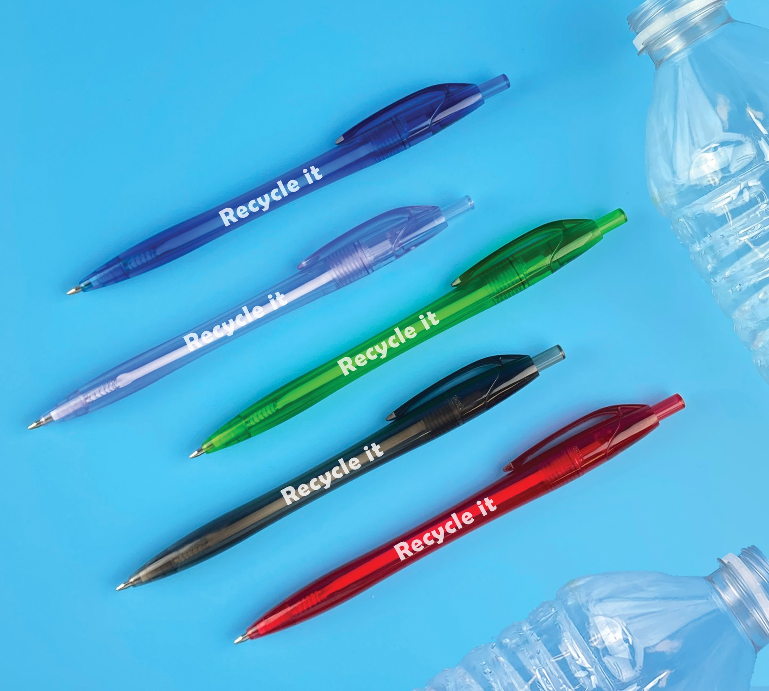
JAVALINA REVIVE
®
(Item No: 296)
Eco-friendly Javalina composed of recycled PET water bottles
Vivid translucent barrels and a clear option with just a hint of blue
Black ultrasmooth anti-fraud ink for a safer writing experience
Good through 12/31/2022. 1 Color silkscreen setup $15. FREE 24 Hour Rush Service available, restrictions apply. Standard production is five business days. FOB MA. All pricing in USD and subject to change. Complete product information available.

