Slide 1
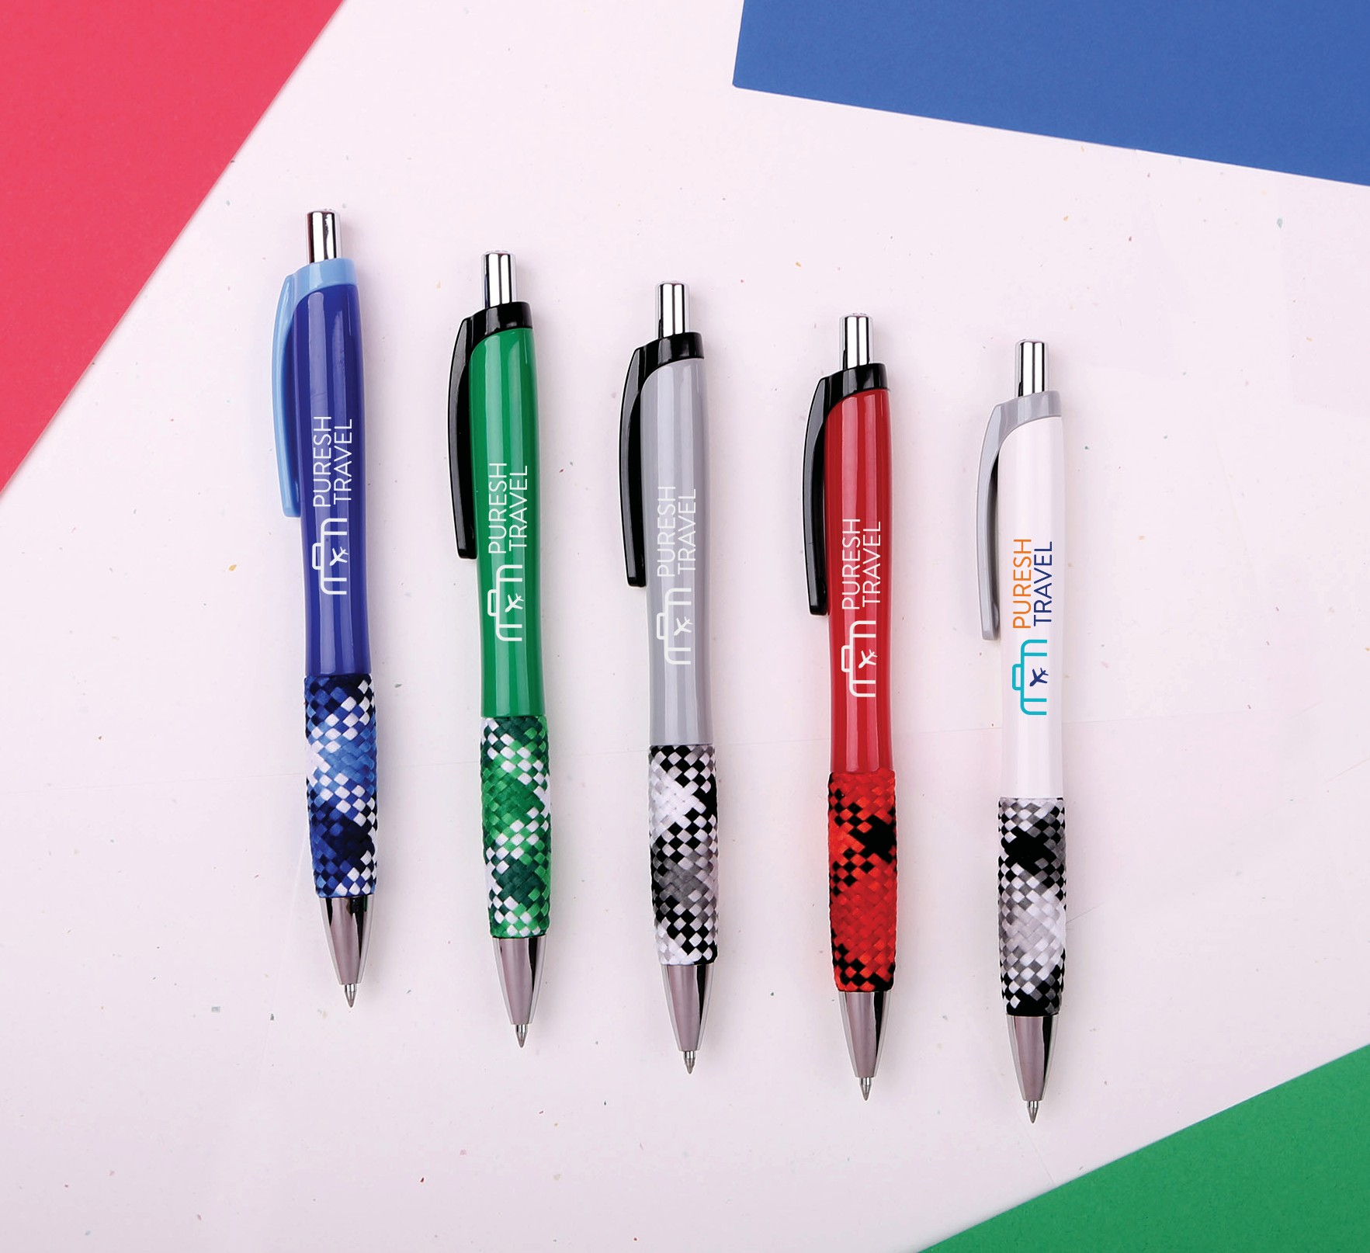
CARDIGAN
(Item No: 423)
The ergonomic shape and smooth writing gel ink offer a pleasing writing experience. Add your brand to a fun and unique pen with a large imprint area. Great for brands that are looking to stand out.
Full Color
Good through 12/31/2022. 1 Color silkscreen setup $15. Optional full color imprints available, additional charges and restrictions apply. Standard production is five business days. FOB MA. All pricing in USD and subject to change.

