Slide 1
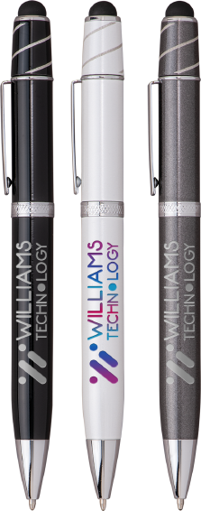
WIZZARD
(Item No: 820)
This twist retraction metal stylus pen features a fun fidget spinner on top that whizzes around with a flick of your thumb. The Jumbo barrel offers ergonomic comfort and black anti-fraud ink for writing excellence. Engraved silver imprint and etched center band.
FULL COLOR WHITE PEN ONLY
Good through 12/30/2022. Laser setup value $45. Optional full color imprints available, additional charges and restrictions apply. Standard production is 7 business days. FOB MA. All pricing in USD and subject to change.

