Slide 1
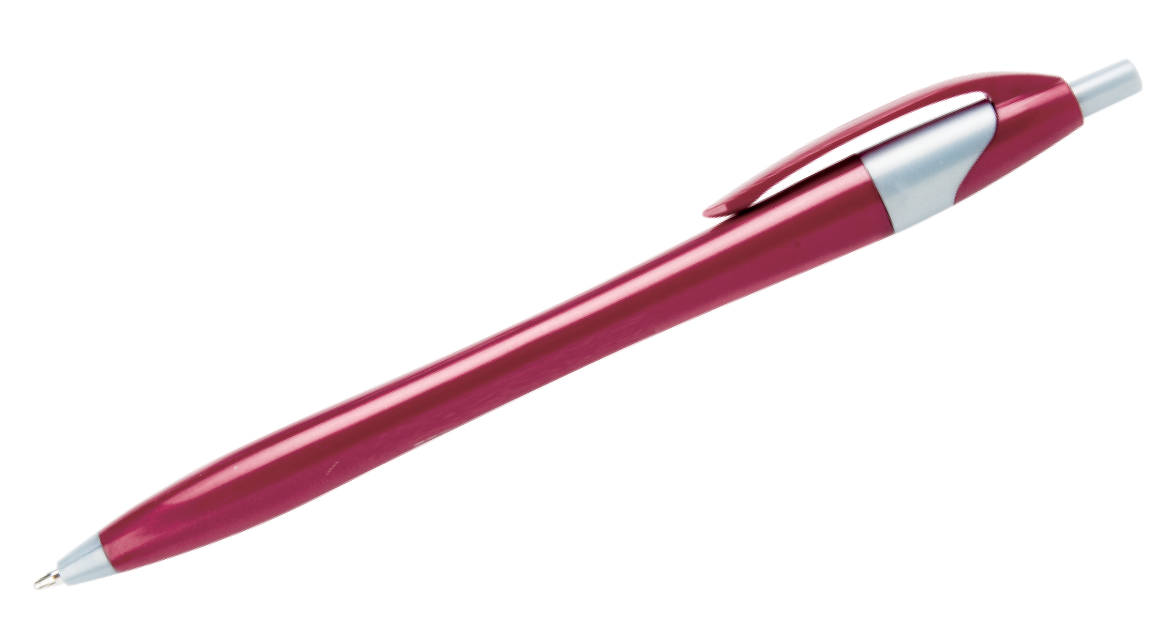
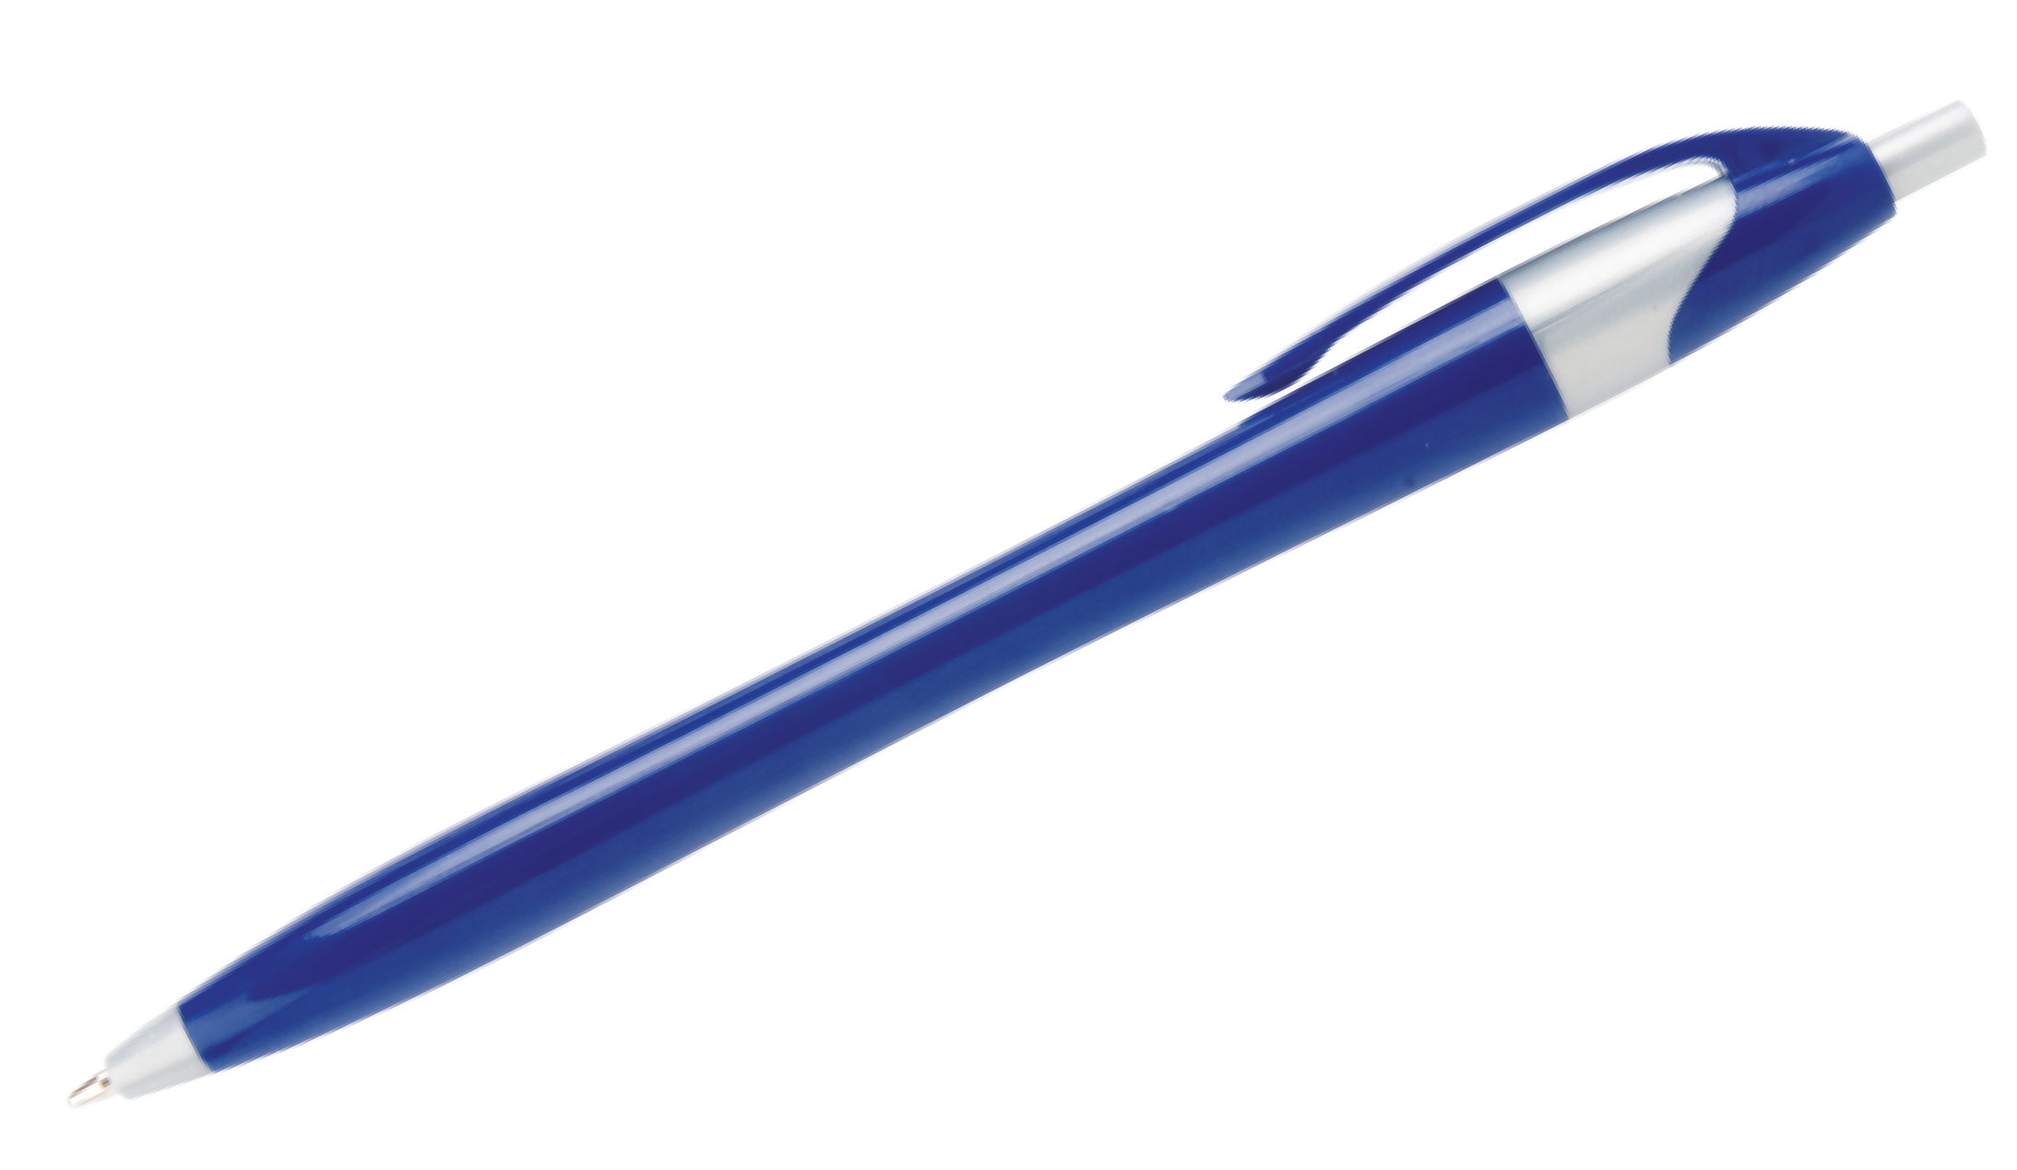
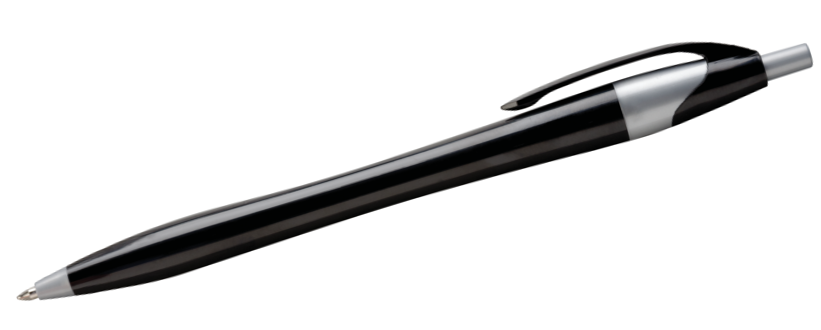
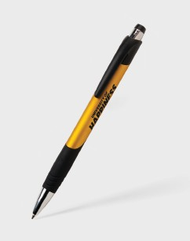
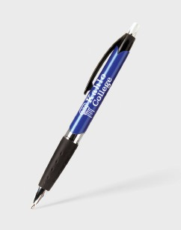
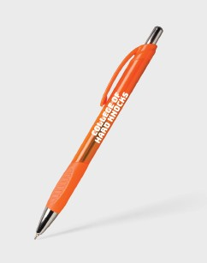
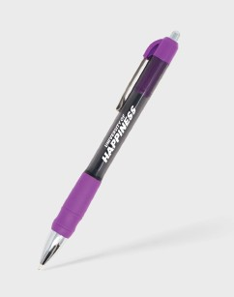
hub unive rsity
hub unive rsity
Javalina® Corporate Item: 324
1
Fiji™ Item: 359
Cubano Item: 428
Macaw® Item: 307
MaxGlide® Color Write Item: 583
Good through 12/31/2022. 1 Color silkscreen setup $15. Optional two and full color imprints available, additional charges and restrictions apply. FREE 24 hour rush service available, restrictions apply. Standard production is five business days. FOB MA. All pricing in USD and subject to change.

