Slide 1
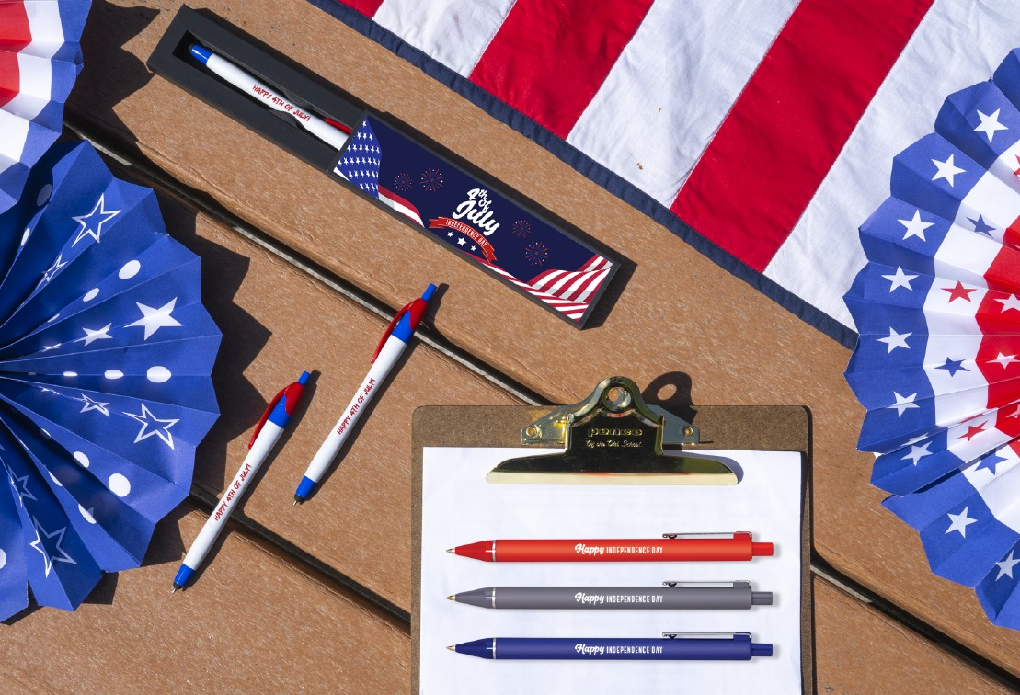
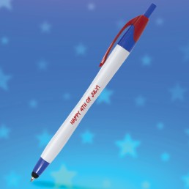
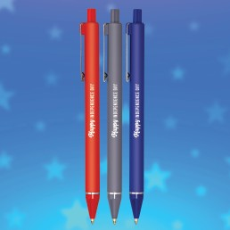
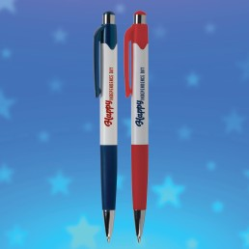
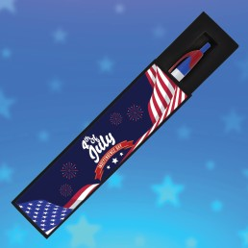
Are you ready to celebrate the
Great options for Independence Day celebrations.
1 2
3
4
Javalina® Classic
Aquarius
Mardi Gras®
Tux Gift
Stylus
Item: 332
Comfort
Item: 291
1
Jubilee
Item: 412
1
Box
Item: TUXBOX
Good through 12/31/2022. 1 Color silkscreen setup $15. Optional two and full color imprints available, additional charges and restrictions apply. FREE 24 hour rush service available, restrictions apply. Standard production is five business days. FOB MA. All pricing in USD and subject to change. Complete product information available at hpgbrands.com/hub.

