Slide 1
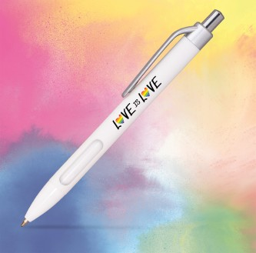
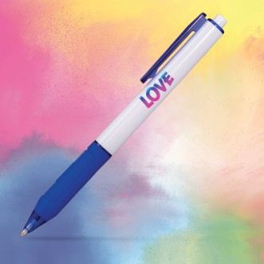
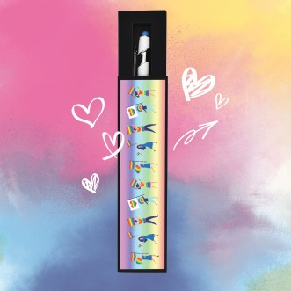
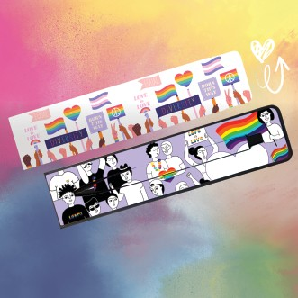
June is Pride Month and you can celebrate every day with these full-color pens and gift boxes. Great for restaurants, bars, pride events, campaigns, and more.
Puma Comfort
ITEM: 293
Vinyasa Grip
ITEM: 295
Tux Gift Box
ITEM: TUXBOX
Tabellone Pen & Box Set
ITEM: 501SET
Textari® Bali
ITEM: PRISMBOX
Good through 12/31/2022. 1 Color silkscreen setup $15. Optional full color imprints available, additional charges and restrictions apply. Standard production is five business days. FOB MA. All pricing in USD and subject to change.

