Slide 1
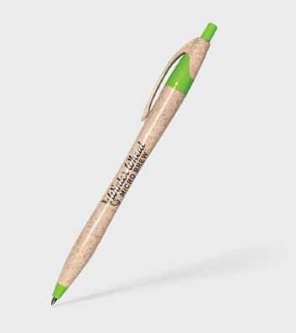
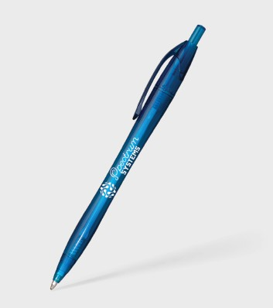
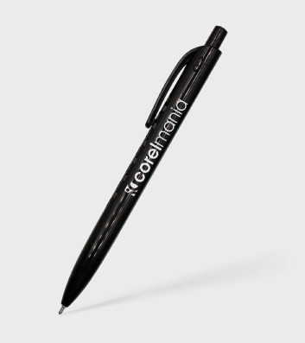
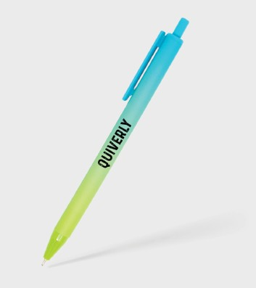
Eco, Colorful & Affordable giveaways to get your brand seen and remembered.
Javalina® Eco
Item: 311
Javalina® Revive
Item: 296
Enviro
Lemonade Comfort
Item: 263
Item: 424
Good through 12/31/2022. 1 Color silkscreen setup $15. Optional two and full color imprints available, additional charges and restrictions apply. FREE 24 hour rush service available, restrictions apply.
Standard production is five business days. FOB MA. All pricing in USD and subject to change.

